Slide 1

Agile Project Planning and Execution Using Scrum

Slide 2
Faculty & Participants An Introduction Name, Role, Experience, Current Challenge, Hobby

Slide 3
We love our clients…
Zerone consulting
IBS
Assyst International
Accenture
Oracle
HP
LG
Amdocs
Sasken
Zylog
Torry Harris
Birla soft
Think3
Tesco
National Bank of Dubai
Tyco
iSOFT
Infotech
Impiger tech
KPMG
ARS software
Razor gator
Volvo
Damac
SRIT
Everett
Capco
Societe General
Aztec
Broadcom
Blues Star
Tejus Networks
Vmoksha
Tejari
Lucent etc…etc….
Cognizant
Genpact

Slide 4
To get the best results...
Postpone
Voice of judgment
Voice of cynicism
Voice of fear
Mono task.....
Calls from home..pls take...

Slide 5
Working Agreements
Electronics
Participation
Time Management
Start & End Time
Breaks

Slide 6
Why are you attending?
Lets a write a test case for this training?

Slide 7
Plan the course
Agile Values & Principles
Scrum Framework
Scrum Values
Scrum Roles
Scrum Planning
Scrum Artifacts
Some Important Concepts

Slide 8
Why this?
Standish Group Prepares Chaos Reports Regularly.
1994: Only 16% of the projects are successful, based on their triple constraints
2004: 29%
2009: 32%

Slide 9
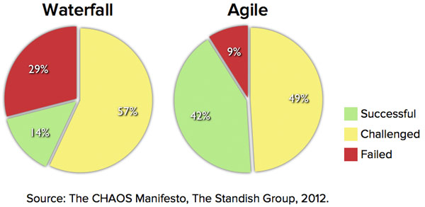
Process Success with Agile Methods
Why this huge change in data?
Definition of Success was left to participants. Only 8% agreed that all three constraints important for them to make a project Success

Slide 10
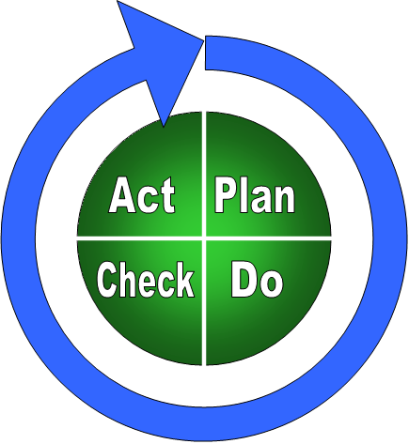
Predictive
PMBOK
PRINCE

Slide 11
Cultural aspects of predictive styles
Any variance is considered as evil
Focus is on Time , Cost and Scope
Very often the project teams can be insensitive to the business case of the project

Slide 12
Adaptive
SCRUM
XP
Crystal family
Many Others......
Notes:
Plan Do Study Act, Deming circle/cycle/wheel, Shewhart cycle, control circle/cycle

Slide 13
When to go agile? Exploration factor
Product Requirements | Bleeding edge | Leading edge | Familiar | Well known
Erratic | 10 | 8 | 7 | 7
Fluctuating | 8 | 7 | 6 | 5
Routine | 7 | 6 | 4 | 3
Stable | 7 | 5 | 3 | 1

Slide 14
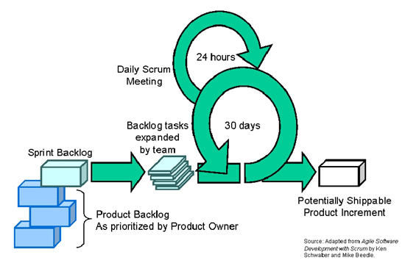
SCRUM framework

Slide 15

Scrum origins
Jeff Sutherland
Initial Scrums at Easel Corp in 1993
IDX and nearly 600 people doing Scrum
Not just for trivial projects
FDA-approved, life-critical software for x-rays and MRIs
Ken Schwaber
ADM (Adaptive Dev Methods)
Initial definitions of Scrum at OOPSLA 96 with Sutherland
Mike Beedle
Scrum patterns in PLOPD4
Scrum

Slide 16
Exercise- 1
Defined Process Vs Empirical Process
Scrum

Slide 17
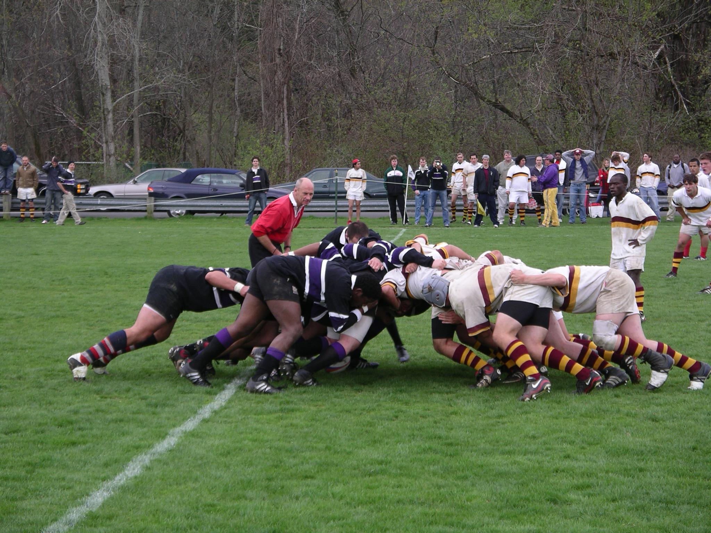
Involved People
(Chickens)
Scrum Master
Committed People (Pigs)

Slide 18
SCRUM Values
Commitment
Be willing to commit to a goal. Scrum provides people all the authority they need to meet their commitments
Focus
Do your job. Focus all your efforts and skills on doing the work you have committed to doing. Don’t worry about anything else

Slide 19
SCRUM Values
Openness
Scrum keeps everything about a project visible to everyone
Respect
Individuals are shaped by their background and their experiences. It is important to respect the different people who comprise a team

Slide 20
Scrum Values
Courage
Have the courage to commit, to act, to be open and to expect respect

Slide 21
Manifesto for Agile Software Development
Individuals and interactions over process and tools
Working software over comprehensive documentation
Customer collaboration over contract negotiation
Responding to change over following a plan
That is, while there is value in the items on the right, we value the items on the left more.

Slide 22
The 12 agile principles
Our highest priority is to satisfy the customer through early and continuous delivery of valuable software.
Welcome changing requirements, even late in development. Agile processes harness change for the customer’s competitive advantage.
Deliver working software frequently, from a couple of weeks to a couple of months, with a preference to the shorter time scale.
Business people and developers must work together daily throughout the project

Slide 23
The 12 agile principles
Build projects around motivated individuals. Give them the environment and support they need, and trust them to get the job done.
The most effective method of conveying information to and within a development team is face-to-face conversation.
Working software is the primary measure of progress.
Agile processes promote sustainable development. The sponsors, developers and users should be able to maintain a constant pace indefinitely.

Slide 24
The 12 agile principles
Continuous attention to technical excellence and good design enhances agility.
Simplicity – the art of maximizing the amount of unwanted work not done – is essential.
The best architectures, requirements and designs emerge from self organizing teams.
At regular intervals, the team reflects on how to become more effective, then tunes and adjusts it’s behavior accordingly.

Slide 25

Agile methods (including SCRUM) are value/principle based,
rather than rule-based

Slide 26
Exercise -2
Break into teams, and develop a team charter based on the agile principles and values
Should be documented on an A4 sized document
Should reflect the agile principles and values
All the team members should sign on it

Slide 27
Scrum theory
Founded on empiricism
Knowledge comes from experience
Making decisions based on what is known
Iterative incremental approach
Risk control
Transparency
Adaptation

Slide 28
Methodology Vs Framework
SCRUM is a framework NOT a methodology
SCRUM is not going to tell you exactly what to do…

Slide 29
Sprint
In XP it is also called “Iterations”
Fixed duration for which team commits a potentially shippable product to Product Owner
Product is understood, designed, coded, tested and demo and delivered in a sprint.
The duration can vary from 1-6 weeks depending on agile method chosen and project characters
In Scrum ideal duration is 4 weeks.
The duration is NOT variable and it is decided at the start of project. What if it vary??
If work committed cannot be done in a sprint work duration cannot be extended but work is moved into next sprint
No extra time for testing and bug fixing

Slide 30
Lets Start Sprints

Slide 31

Sprint -1 - Scrum framework - Product backlog - User stories

Slide 32
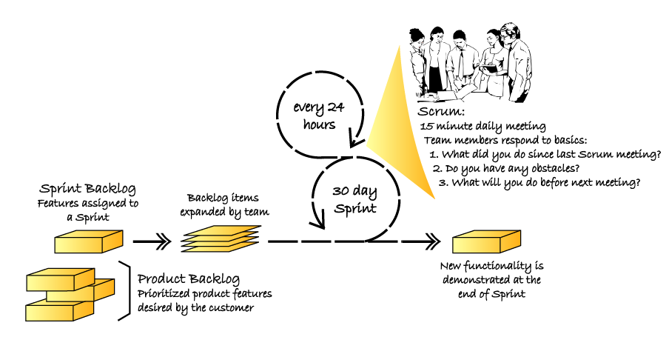
Scrum framework

Slide 33
What is a product backlog?
A wish list of features (user stories)
Continuously growing (product backlog grooming)
Owned by the product owner
Prioritized (based on risk, cost, value)
Tells you what need to be tested?
When stops growing – indication that the product is reaching end of life !

Slide 34
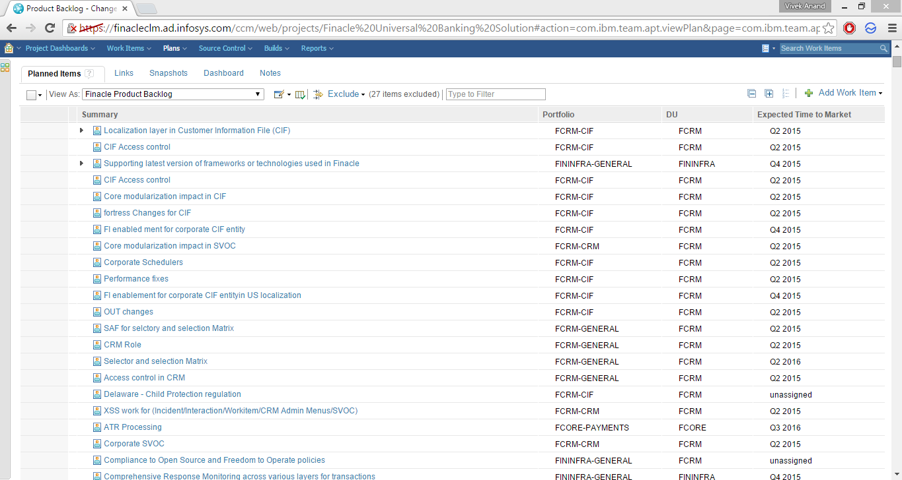
Product Backlog (RTC)

Slide 35
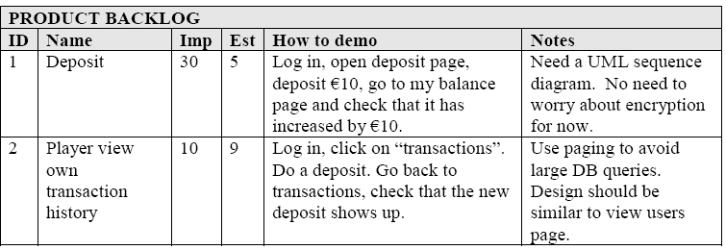
Product backlog

Slide 36
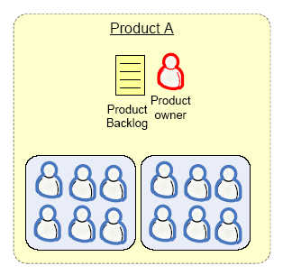
One product owner – one backlog
Ideal

Slide 37
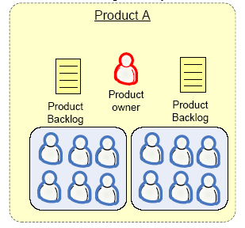
One product owner – multiple backlogs

Slide 38
Multiple product owners, one backlog

Slide 39
User story
A user story concept is kernel of Agile Project Management
A user story is work which a user want system to accomplish because it meets some of his objectives.
A user story is not functional specification document. It is a promise of product owner to the team that he will explain the requirements in details when the team is working on this
User story template
“As a user I want to accomplish something so that business value”
Every user story must have acceptance test cases

Slide 40
3C of User story
Card
Conversation
Confirmation

Slide 41
Types of User Stories
Business user story
“As a class teacher I want to mark attendance of student so that we can issue them certificate”
Bug user story
“An error message is displayed whenever I try to save file in pdf format”
Technical user / Technical Spikes story
“Research a search component in .NET3.5 which is fit for our application”
Non-functional user story
“The Student Affairs Information System is up and running 99.9% during the registration time period defined in the Academic Calendar.”
Documentation user story
“Develop a user manual for teachers to use teacher module”

Slide 42
Theme, Epic, Feature, Story, Task
Epic is a collection of features. An epic is typically 1-3 months in duration
Feature is collection of stories. A feature is typically 2-4 weeks in duration
User-story is smallest unit of requirement created from features. A user-story is typically less than a week in duration
Task are smallest unit of executable items which team members assign to themselves to complete a user story. A task is typically of 8 hours in duration
A group of related user stories is known as theme

Slide 43
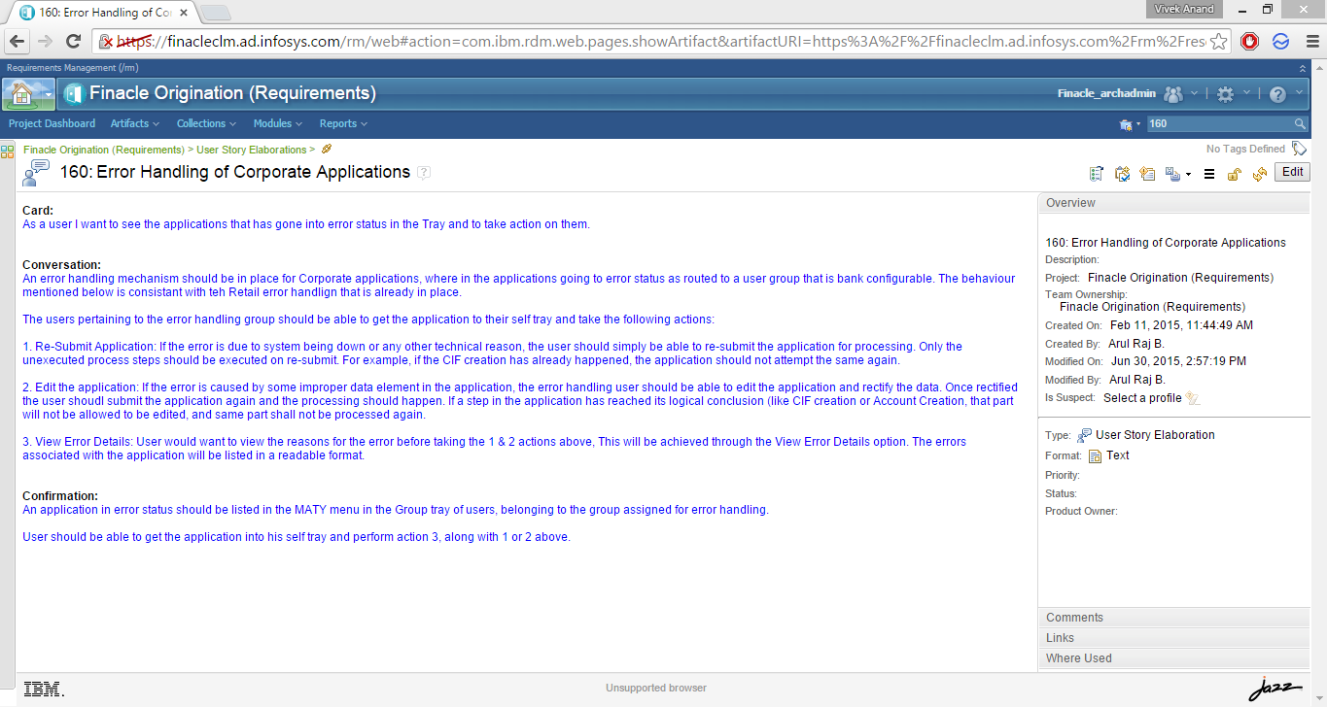
User Story Elaboration (RDNG)

Slide 44
I.N.V.E.S.T Model of User Story
I – Independent
N – Negotiable
V – Valuable to users / customers
E – Estimatable
S – Small
T – Testable

Slide 45
Techniques
User interviews
Questionnaires
Observation
Story writing workshops

Slide 46
Exercise – 3 (User Story)
Banking Account Application
In a group write user stories.
A story in a card.

Slide 47
Sprint -2 - Estimation - Story Points - Ideal Days

Slide 48
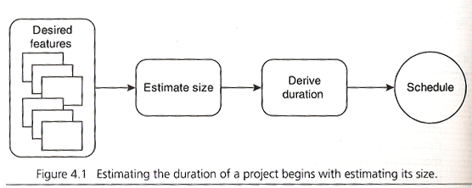
Estimation steps

Slide 49
Most Common techniques
Wideband Delphi
Relative Size Estimation
Planning Poker
Mute Mapping
You Use either or any combination of below techniques to above methods.
Expert Judgement
Analogy
Bottom Up
Top Down

Slide 50
The Estimation Scale
0,1,2,3,5 and 8 (Fibonacci/Hemchandra series)
1,2,4 and 8 (Geometrical increase)

Slide 51
Output of Estimation Workshop
Estimation of work happens in story points.
User Story # Story Points
Do not estimate durations but complexity
Simple things can take more time and vice versa.

Slide 52
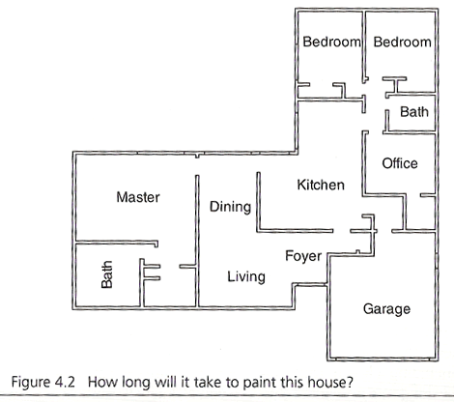
Exercise 4- Estimation
Planning Poker

Slide 53
Story points to schedule
If one ideal day is 1.5 calendar days, how many calendar days are required to complete the painting of the house?

Slide 54
Exercise 5- Estimation
Relative Size Estimation

Slide 55
Exercise 6- Estimation
Mute Mapping

Slide 56
Ideal days
1 ideal day = effective 8 hours of work without any distractions

Slide 57
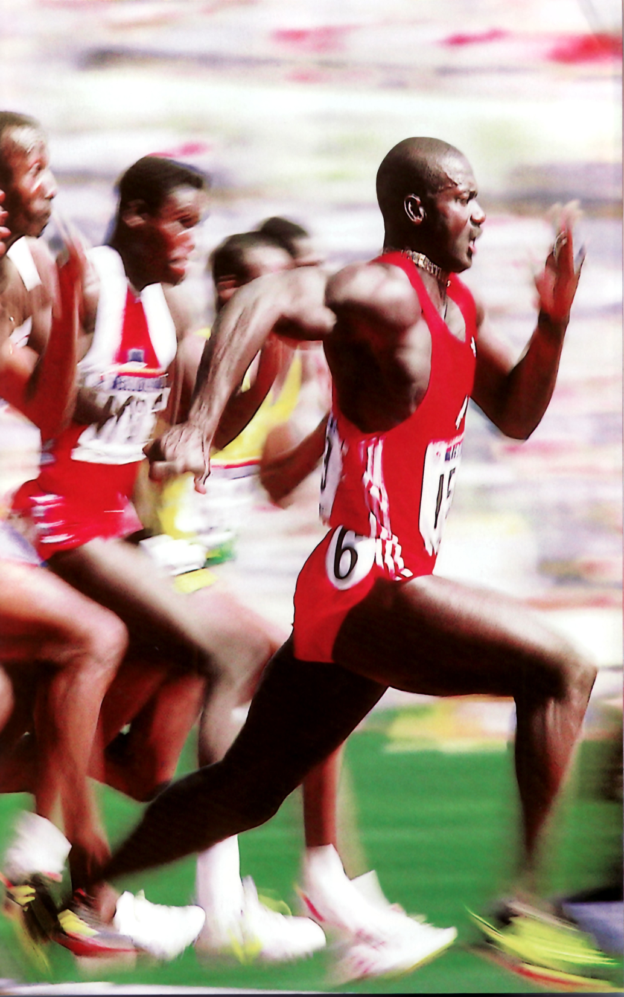
Sprint -3 - Scrum master - Product owner - Team

Slide 58
Scrum Master
Responsible for the success of scrum
Scrum values, practices and rules are enacted and enforced
Represents the management and the team to each other
Conducts all daily scrums
Removes impediments

Slide 59
Product owner
Controls the product backlog
Prioritizes the features to be developed

Slide 60

Scrum Teams
A team commits to achieving a sprint goal. The team is accorded full authority.
Seven +- 2
Cross functional
No titles

Slide 61
Roles
Activity
Owner
Responsibilities
Manage the vision
Product Owner
The Product Owner establishes, nurtures and communicates the product vision.
He achieves initial and on-going funding for the project by creating initial release plans
and the initial Product Backlog.
Manage the ROI
Product Owner
The Product Owner monitors the project against its ROI goals and an investment vision. He updates and prioritizes the Product Backlog to ensure that the most valuable functionality
is produced first and built upon.
He prioritizes and refines the Product Backlog and measures success against expenses.
Manage the
development
iteration
Team
During an iteration the team selects and develops the highest-priority features on the
Product Backlog.
Collectively, the team expands Product Backlog items into more explicit tasks on a Sprint Backlog
and then manages its own work and self-organizes around how it desires to complete the iteration.
The team manages itself to its commitments.
Manage the
process
Scrum Master
The Scrum Master is responsible for setting the team up for success by ensuring the project and
organizational culture are optimized for meeting the ROI goals of the project.
This involves organizing a Sprint Planning Meeting (during which the team expands Product
Backlog into Sprint Backlog), a Sprint Review Meeting (during which the newly developed
functionality is demonstrated), shielding the team from outside disturbances, holding brief
Daily Scrum meetings, and removing obstacles to progress.
Manage the
release
Product Owner
The Product Owner makes decisions about when to create an official release.
For a variety of reasons it may not be desirable to release at the conclusion of every increment.
Similarly, if an official release is planned for after the fifth increment it may be released
(with fewer features) after the fourth increment in order to respond to competitive moves or
capture early market share. The Product Owner makes these decisions in a manner consistent with
the investment vision that has been established for the project.

Slide 62
Introspection
Half way through the sprint, the product owner wants to change the features taken up for sprint. What should be done?
Half way through the sprint the team wants to remove a feature from the sprint. What should be done?

Slide 63
Introspection
One of the team members is unable to complete his tasks on time. What can be done?
The team is lagging behind. As a scrum master what should you do?
A tester wants to do coding. What needs to be done?.

Slide 64
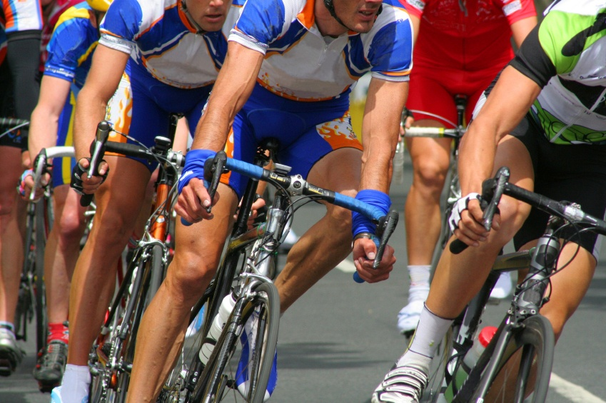
Sprint-4 - Sprint Planning Meeting

Slide 65
Sprint Planning Meeting
Team Capacity
Product Backlog
Analyze, evaluate and
select Product Backlog for Sprint
Estimated Work
Decompose to specifications
and tasks, estimate tasks
Budgeted Work
in Tasks

Slide 66
Sprint Planning Meeting
Scrum
Product Owner
Scrum Team
Customers
Management
Product Backlog
Team Capabilities
Sprint Goal
Sprint Planning
Meeting
Business Conditions
Technology
Sprint Backlog
Current Product

Slide 67
The Sprint Goal
A short “theme” for the sprint:
Life Sciences
“Support features necessary for population genetics studies.”
Database Application
“Make the application run on SQL Server in addition to Oracle.”
Financial Services
“Support more technical indicators than company ABC with real-time, streaming data.”
Scrum

Slide 68
Sprint planning meeting rules
Time boxed into 8 hours
Comprises of two segments of 4 hours each
First segment is for selecting the product backlog
The second segment is for preparing a sprint backlog
Participants
Scrum Master
Product owner
Team
Additional parties can be invited (part time)

Slide 69
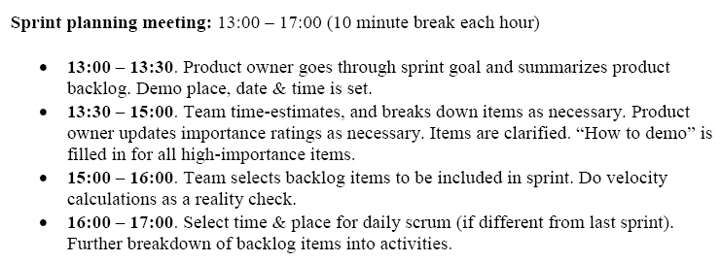
SPRINT planning meeting agenda

Slide 70
Output of sprint planning meeting
A sprint goal
A list of team members, and their commitment levels
A sprint backlog
A defined sprint demo date
A defined time and place for the daily Scrum

Slide 71
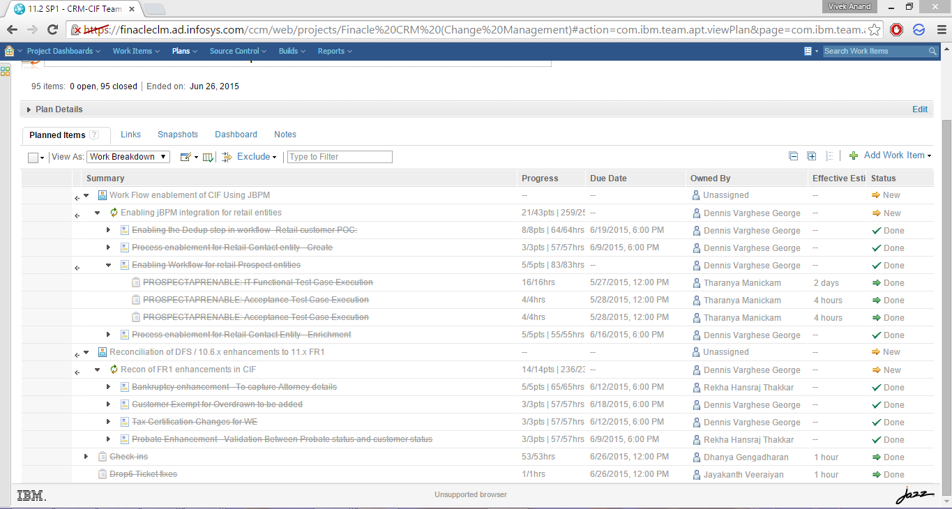
Sprint backlog (RTC)

Slide 72
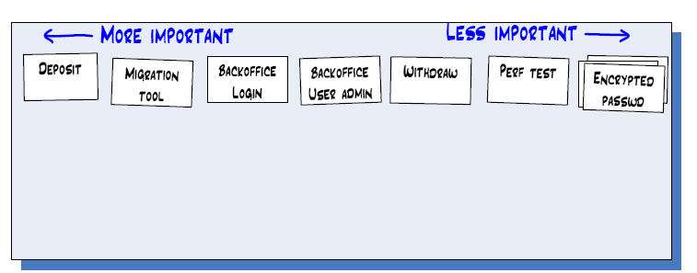
Index cards

Slide 73
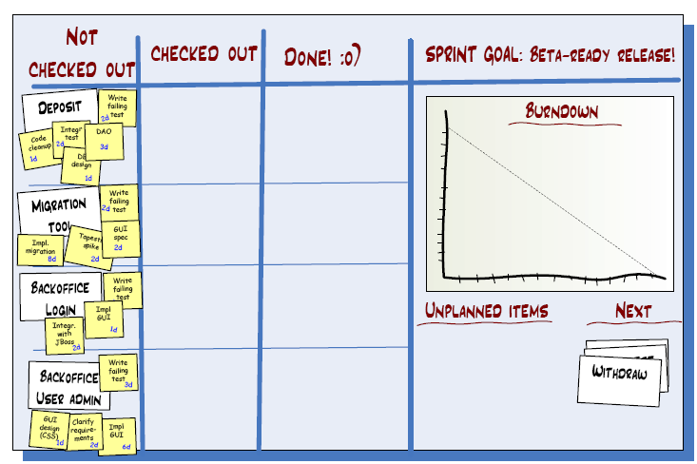
SPRINT backlog

Slide 74
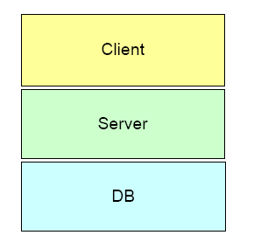
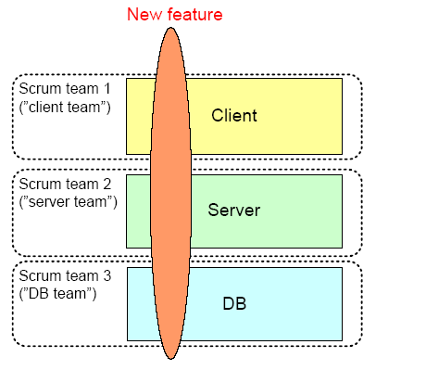
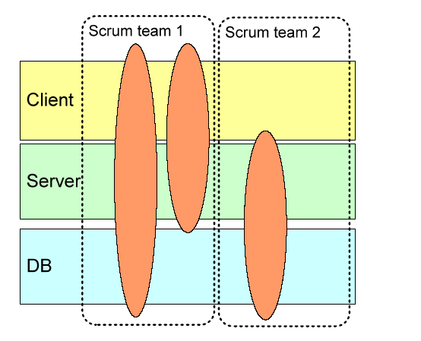
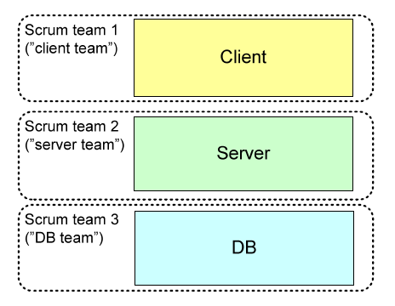
Team strategies

Slide 75
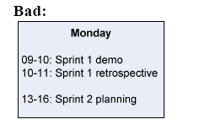
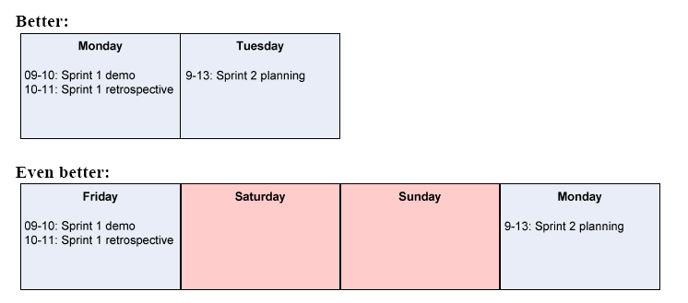
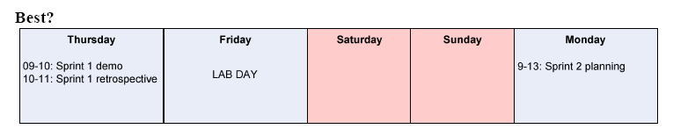
Slack

Slide 76
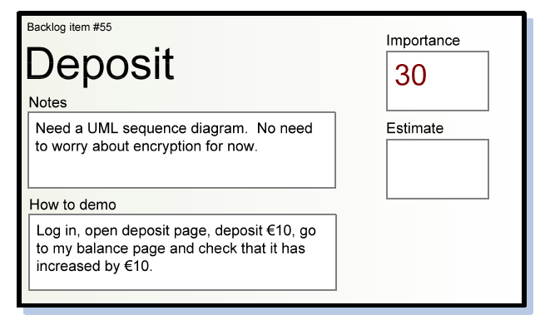
Index card

Slide 77
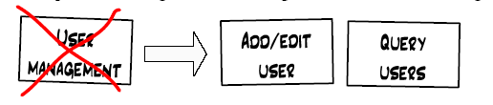
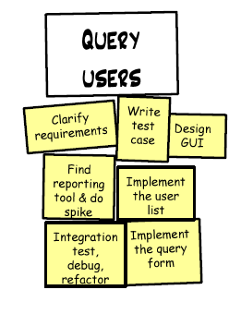
Backlog -> activity lists

Slide 78
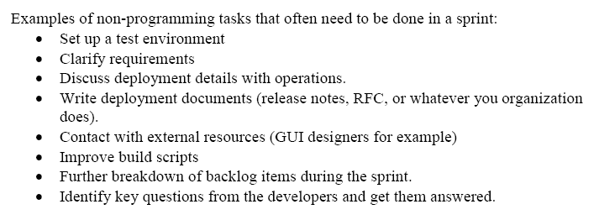
Non programming tasks

Slide 79
SPRINTING
During sprint team must update the boards. Scrumban Board

Slide 80
SPRINT backlog

Slide 81
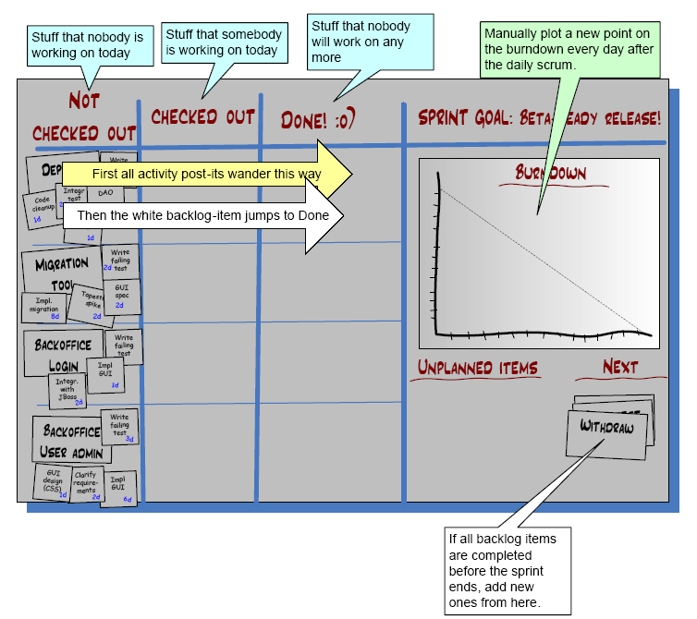
Scrumban Board

Slide 82
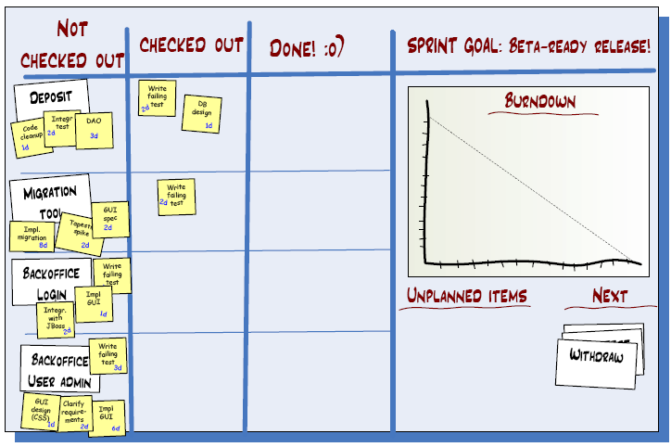
Scrumban Board

Slide 83
Scrumban Board

Slide 85
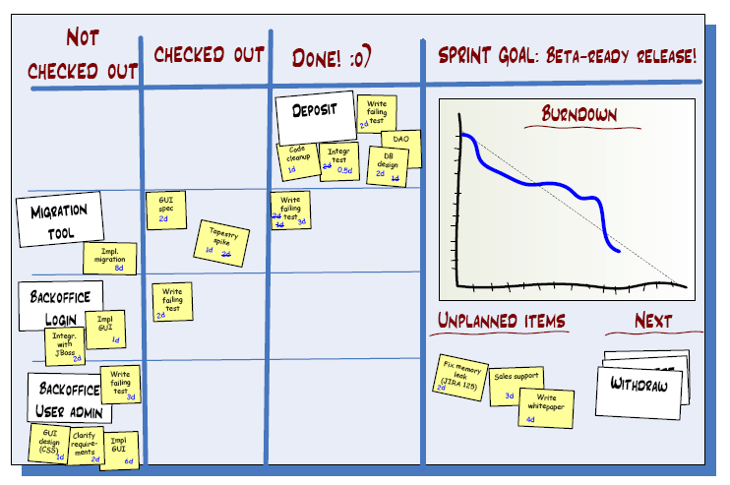
Scrumban Board

Slide 86
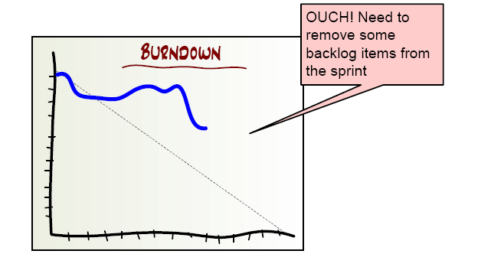

Slide 87
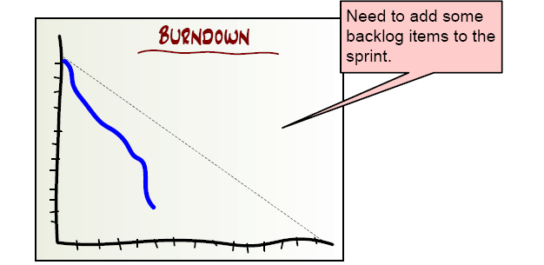

Slide 88
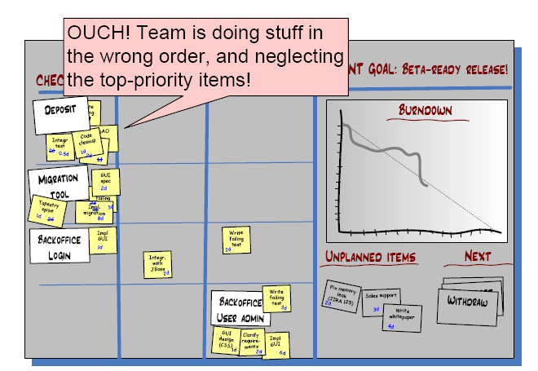
Scrumban Board

Slide 89
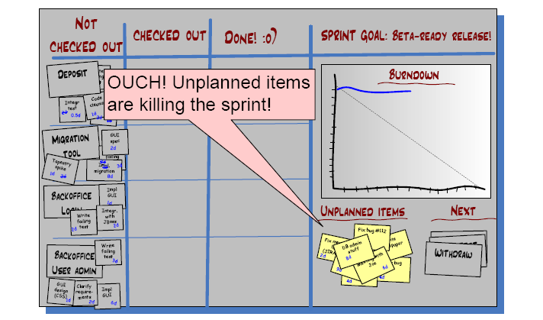
Scrumban Board

Slide 90
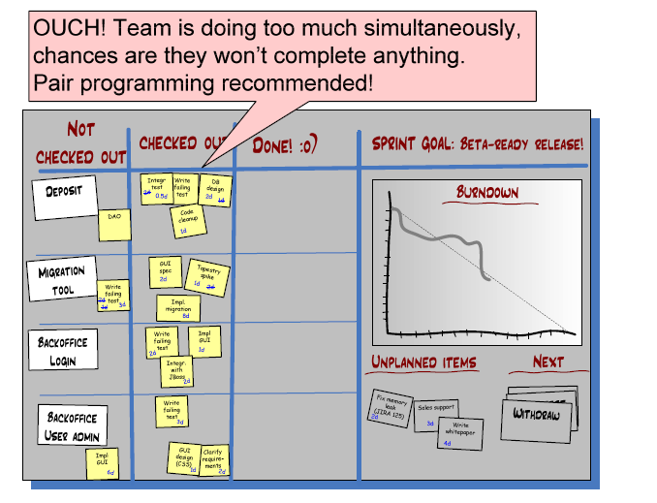
Scrumban Board

Slide 91
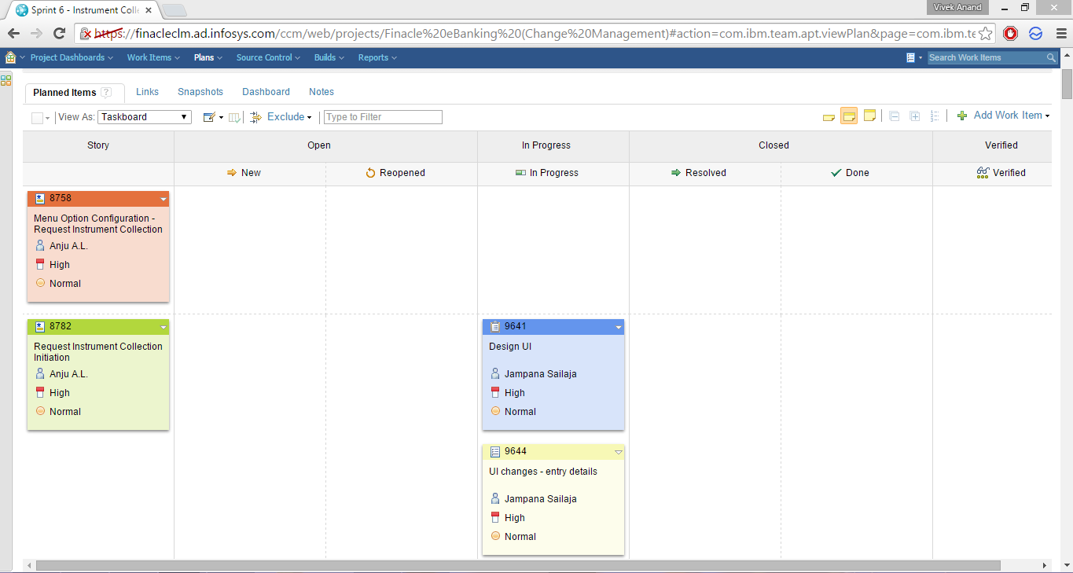
Burn down chart (RTC)

Slide 92
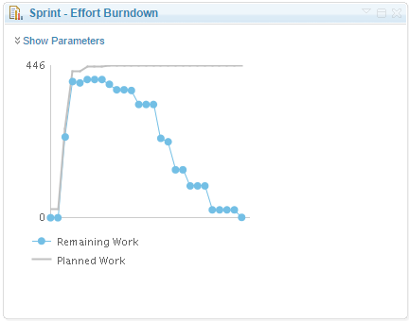
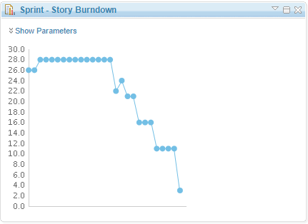
Burn down chart (RTC)

Slide 93
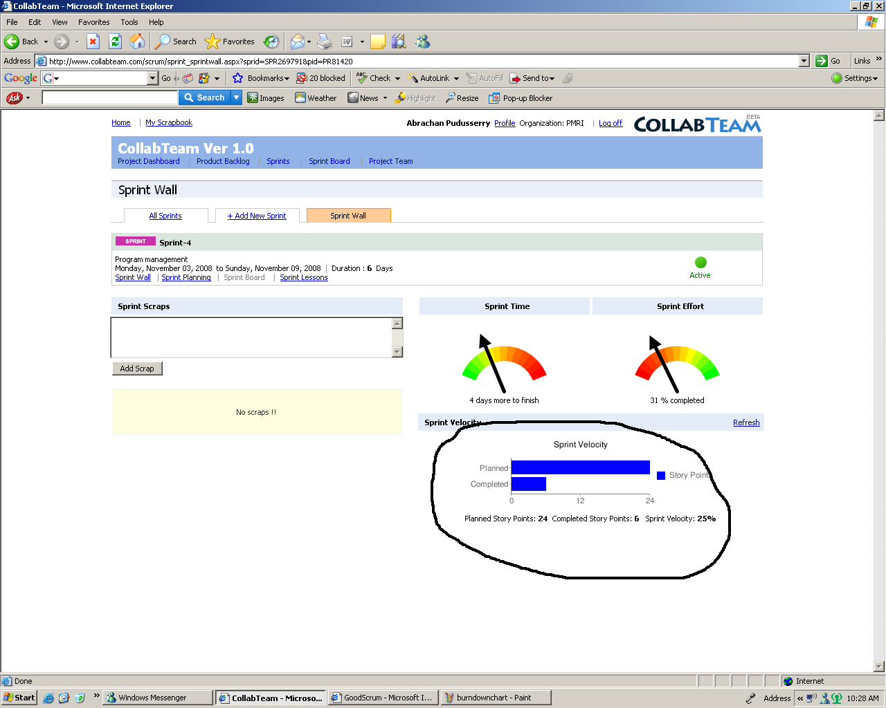
Sprint Velocity

Slide 94
No changes during the sprint
Plan sprint durations around how long you can commit to keeping change out of the sprint
Change
Scrum
Inputs
Sprint
Tested Code

Slide 95

Sprint-6 - Daily Scrum (Stand Up Meeting)

Slide 96
Daily Scrum meetings
Parameters
Daily
15-minutes
Stand-up
Not for problem solving
Three questions:
What did you do yesterday
What will you do today?
What obstacles are in your way?
Management People are invited
Help avoid other unnecessary meetings
Only Scrum Team can talk. No interrogation!
Scrum

Slide 97
During the scrum meeting ….
If required the teams can revise their estimates
No explanation (Just information Sharing)
Update your burn down chart before scrum meeting start
Must discipline yourself to finish the update in structured way in 2 mins.

Slide 98
Questions about Scrum meetings?
Why daily?
“How does a project get to be a year late?”
“One day at a time.”
Fred Brooks, The Mythical Man-Month.
Can Scrum meetings be replaced by emailed status reports?
No
Entire team sees the whole picture every day
Create peer pressure to do what you say you’ll do
Scrum

Slide 99

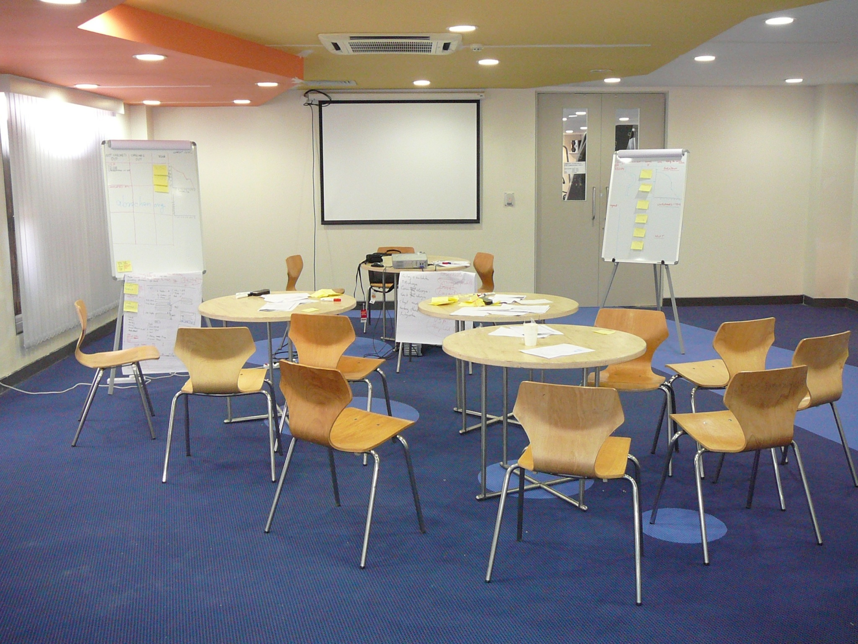
SCRUM
implementing
SCRUM
SCRUM
SCRUM room

Slide 100
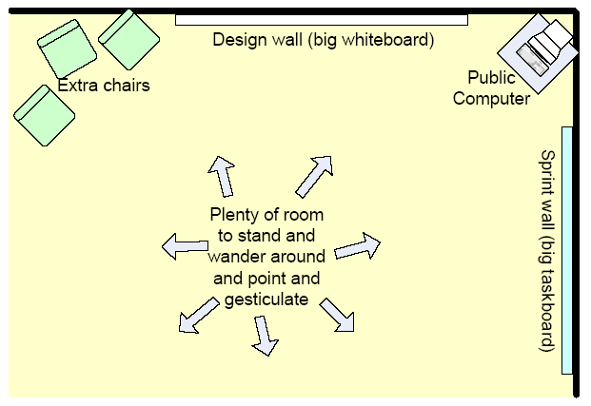
Team room

Slide 101
Introspection
You are supposed to attend a scrum meeting at 10.a.m. The time now is 9.45 a.m and you are held up in a traffic jam. What will you do?

Slide 102
Release Sprints
Sprint1
Sprint2
Sprint3
Sprint4
Sprint5
Sprint6
Sprint7
Release Sprint /Hardening Sprint
Scrum
During a “release sprint”
No extra feature is added
Team prepares a product for release
Final system testing and fixing system issues
Documentation

Slide 103
Exercise 7
A video of Daily Standup

Slide 104
Sprint-7 - Sprint Review Meeting

Slide 105
Sprint reviews
Four hour informational meeting
Demo of the product increment that is built during the sprint
Attended by
Management
Customers
Users
Product owner
Scrum master is responsible for organizing and coordinating

Slide 106
Exercise-8 (Agile Rollout)
Develop a brochure for rolling out scrum
Should contain
Logo
Catch phrase
Key features of scrum
Key social needs it addresses
Benefits to team

Slide 107
Exercise ….
Acceptance test
Should be A4 size
Should be in english
Should have at least 5 social needs
The catch phrase should be within 150 characters
Should have at least 5 key features
Should have at least 5 key benefits to team

Slide 108
Exercise…..
Develop a sprint backlog
Prioritize the features
Break the features into activities
Estimate in ideal days
Transfer it to the white board
Volunteer for work
Write down the volunteers name on the activity

Slide 109
Let us sprint
In 40 minutes time, let us develop the brochure
Every 10 minutes let us perform scrum meetings
After 40 minutes let us conduct a sprint review

Slide 110
Sprint-7 - Retrospectives

Slide 111
Sprint retrospectives
What went right
What went wrong
Techniques for Retrospective
Force Field Analysis
Pomodoro Retrospective
Start-Stop-Continue
Sailboat

Slide 112
Exercise -9
Retrospective

Slide 113
Useful Metrics

Slide 114
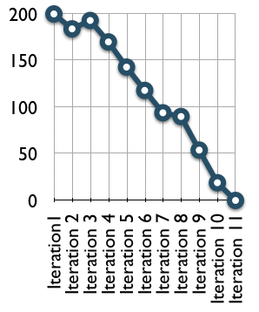
Release burn down

Slide 115
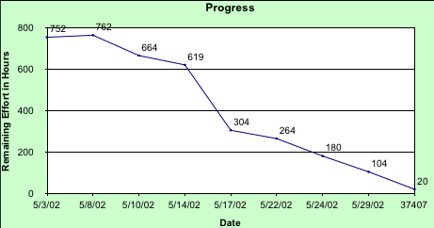
Sprint Burn down Chart
Scrum

Slide 116
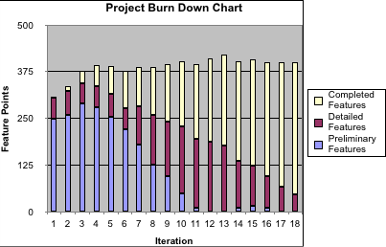
Project Burn Down Charts

Slide 117
Risk Burn Down Chart

Slide 118
Velocity Chart

Slide 119
Tools

Slide 120
Tool Support for Scrum
Doing Scrum requires no tools
Using a tool will not make you do Scrum
Identify your metrics and reporting needs first
Find tools that work with you
Start simple and stay that way
Find tools with unobtrusive touch points
Assign a Toolmeister to handle tool usage

Slide 121
Type of Tools Used by Agile Teams
Collaboration Tools
Whiteboards, wiki, NetMeeting
Communication Tools
Talking, eMail, IM, video conferencing
Management Tools
Big charts, spreadsheets, tracking tools
Development Tools
Version control, build (Ant), automated testing (xUnit, Fit), integration (Cruise Control), IDE w/refactoring support (Eclipse, RefactorIT)

Slide 122
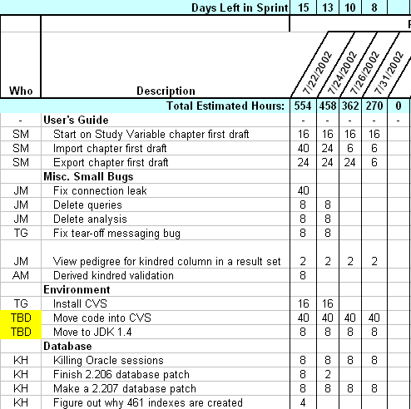
Tool Support
Simple spreadsheets and documents

Slide 123
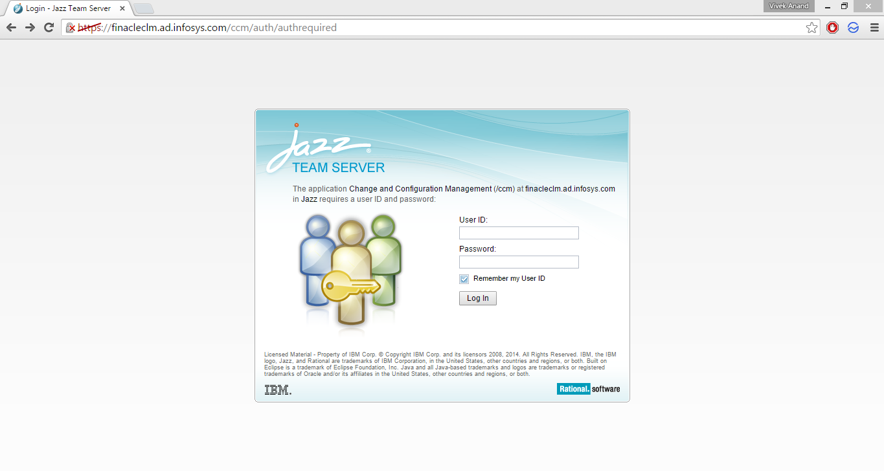

Slide 124
Exercise
Create an account (by administrator)
Create a project
Create users (user id and password)
Create a product backlog
Create a sprint backlog
Sprint
Lessons learned

Slide 125
Sprint-8 Important Concepts in Agile

Slide 126
Agile Product Build
Build complete product, all the time
• One button should produce needed documentation,
build the product executables, create installation
materials, produce test results and tested
components
• Build should also work from command line
• Everyone in team should use the same build process

Slide 127
Agile Documentation
Maximize stakeholder investment. Produce document only when
It is needed by a stakeholder
Needed to define contract model
You need to think something in many iterations involving multiple groups
It is needed for external communication
Document only those things which are least likely to change
First identify the specific customer of the document
The document facilitates in estimating
Sufficiently index, details, accurate and consistent

Slide 128
Agile Testing
All code must have test cases, ideally they should be created earlier
Unit tests should be executed during automated build
A build should be performed many times a time, ideally whenever anything is checked-in or committed to configuration server
If anybody’s code causing crash he should be informed immediately and that person should fix that problem first
All unit test must pass before code can be released

Slide 129
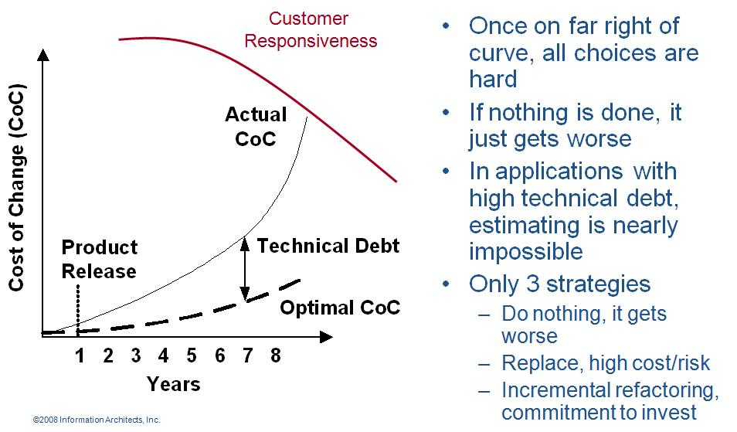
Refactoring
Agile programmer writes simple and bare minimum code they do not complicate the code
Down the line structure the code without changing its behavior. It helps in improving the quality (maintainability, readability) of code

Slide 130
When does Agile Methodologies Works Best?
When problems you are solving have
following characteristics
– Going to change while solving
– Speed of development cannot be determined
– Turbulence in environment
– Customer doesn’t know how exactly it will look
like

Slide 131
Agile Health Checkup
To know the agile maturity in your project you can perform following Agile Health Checkup. Discuss in group and ask team to rate these parameters on the scale of 1-5
Frequent Delivery
Reflective Improvement
Close Communication (does it take less than 1 min to get you question answered by a person who know the answer?)
Focus (everybody understand the goal and desired outcome of the delivered software?)
Personal Safety (can you give bad news to your boss?)
Easy Access to Outside Experts
Strong Technical Environment (SVN used? Test Automation?)
Sunny Day Visibility (Does everyone on the team understand the rate of progress being made on the product?)
Regular Cadence or Rhythm (Is heartbeat of the system on?)

Slide 132
Technical Debt
While writing code agile programmer do not pay attention to structure, duplication etc but to functionality and make sure that code is passing all unit test cases
In this process if they do not clean the code by structuring (refactoring) it will become unreadable and un-maintainable and over a period of time this cause increases response time to fix the problems, adding new feature and deteriorate the quality.
The concept of unclean code is called technical debt. Technical debt keep increasing over the period of time therefore Agile team need to pay this debt back by putting efforts in refactoring.

Slide 133
Travel Light
Simple Design (Do Simple Things). Simplify Vigorously
You Aren’t Gonna Need It (YAGNI),
Once And Only Once (DRY),
TAGRI (They aren't gonna Read It)

Slide 134
Osmotic Communication
Agile project relies on collocation, minimum documentation, least reporting, maximum constructive engagement. This can be achieved if frequently sought important information is available in published form in team space
Whoever need the information can go and get the information without wasting time in requesting, making, sending, receiving the information
Benefits
Least cost, effort and time waste in communication
Updated information is always available without making new reports
People can get whatever particular information they are looking for
Happens at the same time
Feedback loop is quick
Those people who are left in regular reporting also get benefitted
No junk, old, repetitive information, but fresh and useful.
Dis-benefits
Some people get extra information which they do not need
It is left to individual’s interpretation

Slide 135
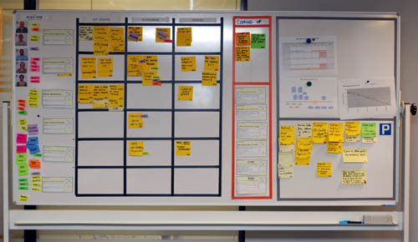
Information Radiator
Team Members
Work Progress
Impediments
Work Progress
Work Completed
Parking Lot

Slide 136
Time-boxing
Iteration length is time-boxed.
Following sequence of activities takes place in any time-boxed iteration
Grooming product backlog (done by product owner, in parallel to iteration work)
Iteration Planning (1 hour for every week of iteration)
Daily stand-up (15 min, max 2 min for one person, typical team size of agile team is 7±2)
Regular iteration work
Iteration Review (1 hour for every week of iteration)
Iteration Retrospective (1 hours for every week of iteration)

Slide 137
Definition of Done (DoD)
The DoD changes over time. Organizational support and the team’s ability to remove impediments may enable the inclusion of additional activities into the DoD for features or sprints.
Continuous Integration (CI) helps you validating the “Doneness”
There are 3 level of DoD
Story DoD
Iteration DoD
Release DoD

Slide 138
Definition of Done (DoD)
Story “Done”
Unit test should provide 60-70% test coverage
Story is either written in pair or reviewed by peer
All code checked in
All unit code passed
All acceptance test case passed
Story accepted by owner

Slide 139
Definition of Done (DoD)
Iteration “Done”
Iteration should have defined Iteration Goal
All acceptance test cases should run for all user stories in Iteration
All stories completed must be accepted by the product owner
Defects identified are fixed or planned for future
Code performance is tested and accepted
If database is involved then database script should be available, automated and tested
Backup of iteration work product is taken

Slide 140
Definition of Done (DoD)
Release “Done”
Release should have defined Release Goal
Product has formal release date
Product is deployed on staging area
Stress testing done and results accepted
All non-functional requirements are tested and results accepted
Required documentation is available
Release should not have any known bug

Slide 141

Risk Burn-down Graph
Actual Risk Trend line
Ideal Risk Trend line
If actual risk trend line is above than ideal trend line then it means risks are not coming down at the appropriate rate

Slide 142
What is Best Time?
Sprint Planning
Product Demo
Stand up meeting
Product Backlog Grooming
Retrospective Meeting

Slide 143
Scaling Scrum

Slide 144

SCRUM of SCRUMS

Slide 145
Scrum of Scrums / Meta-Scrum
Scrum

Slide 146


Multiple teams - Synchronization
Daily Scrums
per Sprint
Sprint 1
9:00AM 9:15AM
9:15AM 9:30AM
Sprint 2
9:30AM 9:45AM
Sprint 3
9:45AM 10:00AM

Slide 147
Comparing with PMBOK, CMM

Slide 148

SCRUM and CMM

Slide 149
SCRUM and PMBOK
Knowledge areas
Integration | Compliant
Time | Compliant
Cost | Compliant
Scope | Compliant
Quality | Compliant
Risk | Partial
Human | Compliant
Procurement | Not applicable
Communication | Compliant

Slide 150
Final Sprint - Scrum Smells

Slide 151

Scrum Smells !

Slide 152


Scrum Smells !

Slide 153



Scrum Smells !

Slide 154


Slide 155


Slide 156

Where to go next?
Scrum
www.mountaingoatsoftware.com/scrum
www.controlchaos.com
scrumdevelopment@yahoogroups.com
Agile Software Development with Scrum
Ken Schwaber and Mike Beedle
Agile Project Management with Scrum
Ken Schwaber and Mike Beedle
General information
www.agilealliance.com
Further Sources

